Slide 1
ERROR HANDLING
Best practice in ASP.NET Web API

Slide 2
Purpose of this presentation
Error handling is often considered too late during projects
Today, Platform handling ≠ Transparency handling
Trace One should use only one error handling model
in order to get
Scenarios exception better defined
Easier debugging
More predictable system

Slide 3
Contents
Categories of errors
Error specification
Setting up the API
Throwing and Catching
Sequence diagrams
Helpers & Converters

Slide 4
Categories of errors
System Errors (Server errors)
Client validation errors
Scenario Exceptions (Client business Errors)
Who is responsible ?

Slide 5
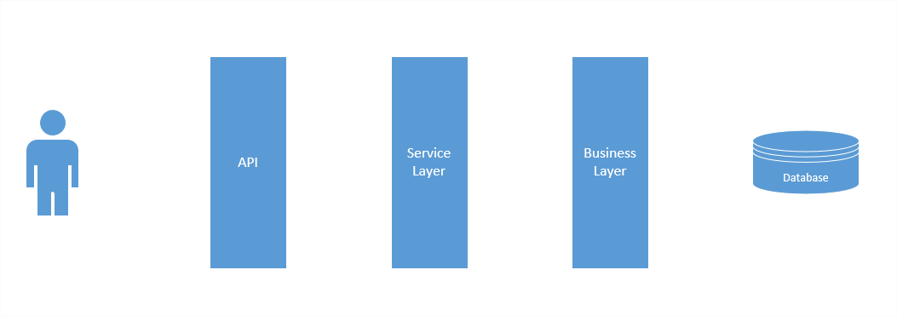

Categories of errors
System Error : the server is responsible
System Exception: Could not connect to database

Slide 6
Categories of errors
System Errors : the server is responsible
null reference exceptions
dictionary not containing keys
unhandled (yet) client errors
timeout exceptions
servers desynchronizations
And many more

Slide 7
Categories of errors
Client validation errors : client is responsible
API contract is not respected
Price is mandatory

Slide 8
Categories of errors
Client validation errors : client is responsible
API contract is not respected
Wrong input
Not authorized
Endpoint not found
Price is mandatory

Slide 9
Categories of errors
Scenario exceptions : client is responsible
A business rule is not respected
Price is too high

Slide 10
Categories of errors
Scenario exceptions : client is responsible
A business rule is not respected
Object not found
Price is too high
Data Conflict
Facility not in your tenant

Slide 11
HTTP Status
Every HTTP request gets an HTTP Response Status
HTTP Status have 3 digits
1XX : Informational
2XX : Sucess
3XX : Redirection
4XX : Client Error (validation or business errors)
5XX : System Error

Slide 12
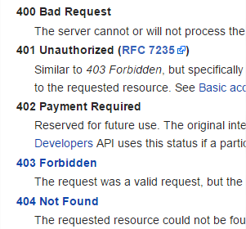
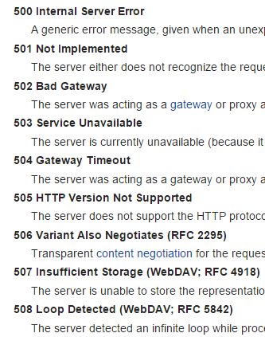
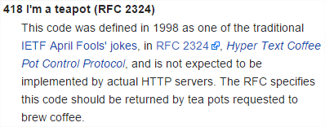

Error HTTP Status
Some client errors
Some server errors
https://en.wikipedia.org/wiki/List_of_HTTP_status_codes

Slide 13
Error Specification

Slide 14
Error Specification
Backend & Frontend need to sync on the error format
It needs to be
Simple
Flexible
Consistent

Slide 15
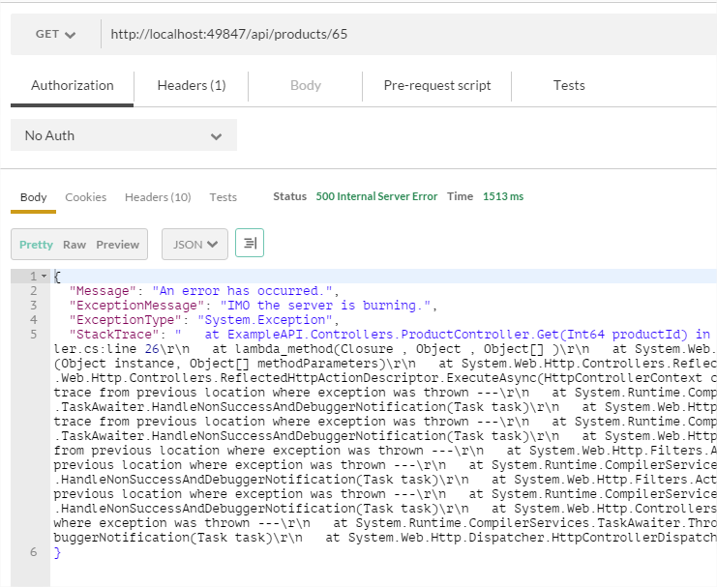
Error Specification
Default ASP.NET Web API errors are not acceptable

Slide 16
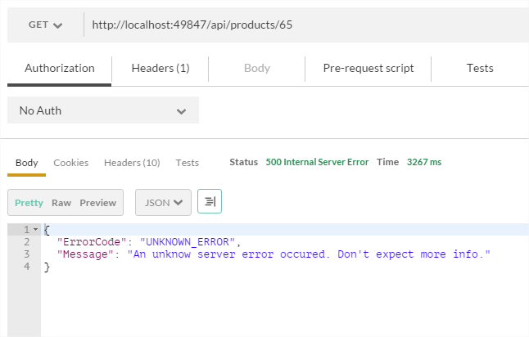
Error Specification
A better format is human readable

Slide 17
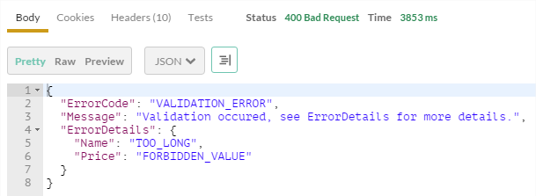
Error Specification
It is flexible for validation
We decide what Http Status to return

Slide 18
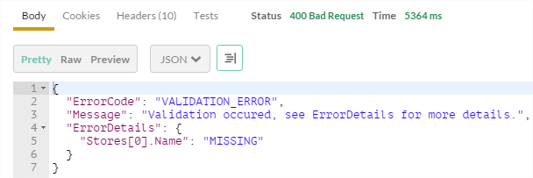
Error Specification
It can handle inner lists or objects

Slide 19
Error Specification
The level of details returned depends on the responsibility

Slide 20
Error Specification
Server errors : minimum info
System Exception: Could not connect to database

Slide 21
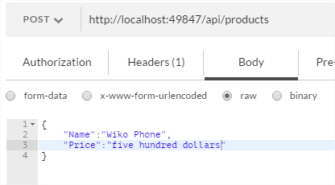
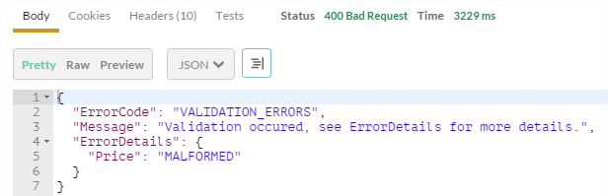
Error Specification
Client validation error : Code + Details

Slide 22
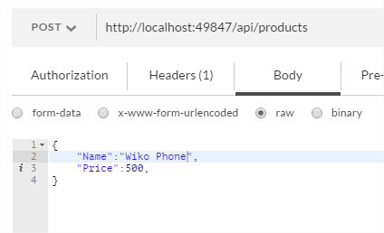
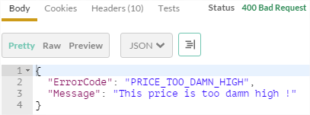
Error Specification
Client errors : business error code

Slide 23
Setting up the API

Slide 24
Setting up the API
The error handling systems essentially relies on usage of attributes for :
Model validation
Actions filtering
Exceptions filtering

Slide 25
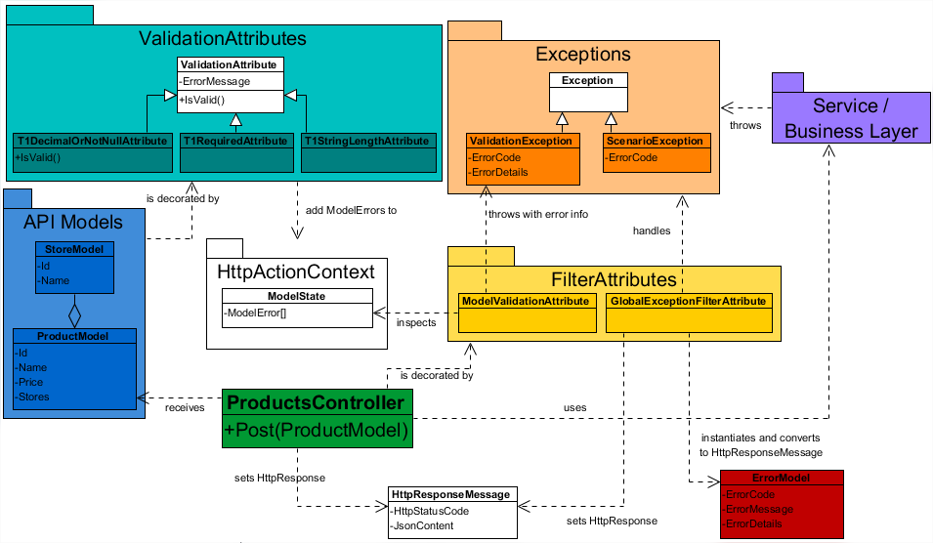
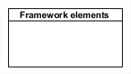
Class Diagram
legend

Slide 26
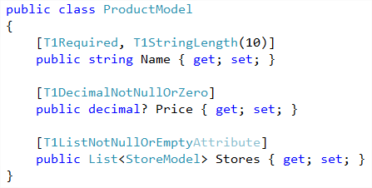
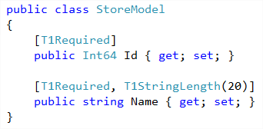
Setting up the API : Models
POCO with Validation attributes

Slide 27
Class Diagram
legend

Slide 28
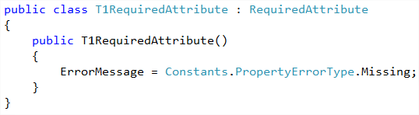
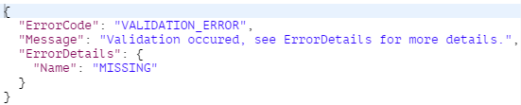
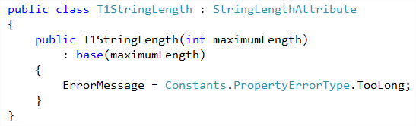
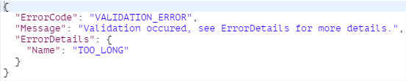
Setting up the API : model attributes

Slide 29
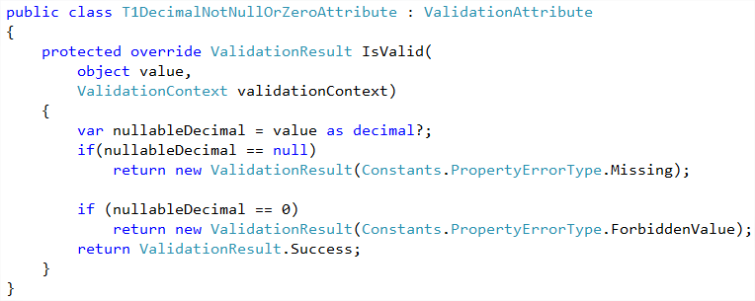
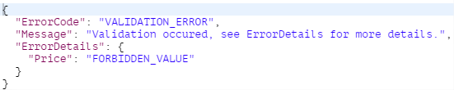
Setting up the API : model attributes

Slide 30
Class Diagram
legend

Slide 31
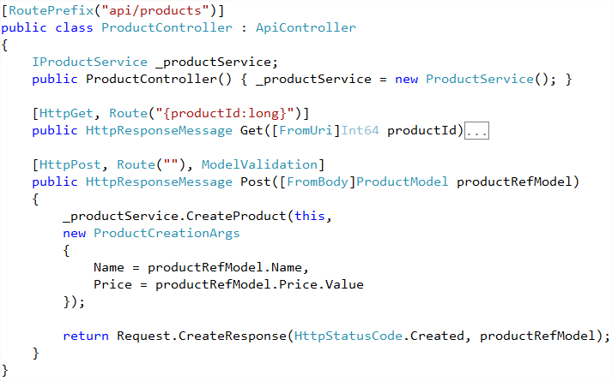
Setting up the API : Controller

Slide 32
Throwing and Catching

Slide 33
Filter Attributes
Filter attributes act as « side code » for actions
(logs, security, validation, exception handling, …)
They can be applied to
Single actions
Entire Controllers
The whole API
They can run before or after the action

Slide 34
Class Diagram
legend

Slide 35
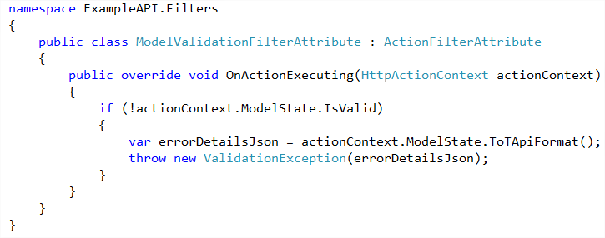
Throwing & Catching : Action Validation Filter
cf model error extraction
Code running just before the decorated actions

Slide 36
Class Diagram : Exception Filter attributes
Core class of the system
legend

Slide 37
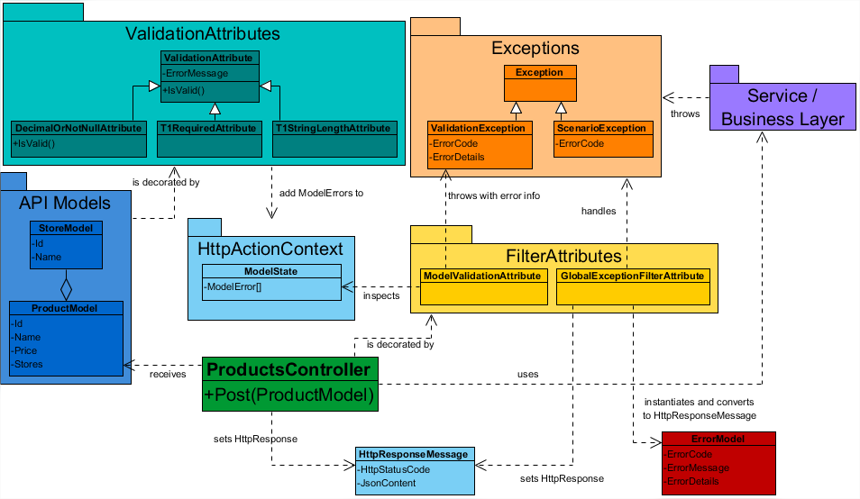
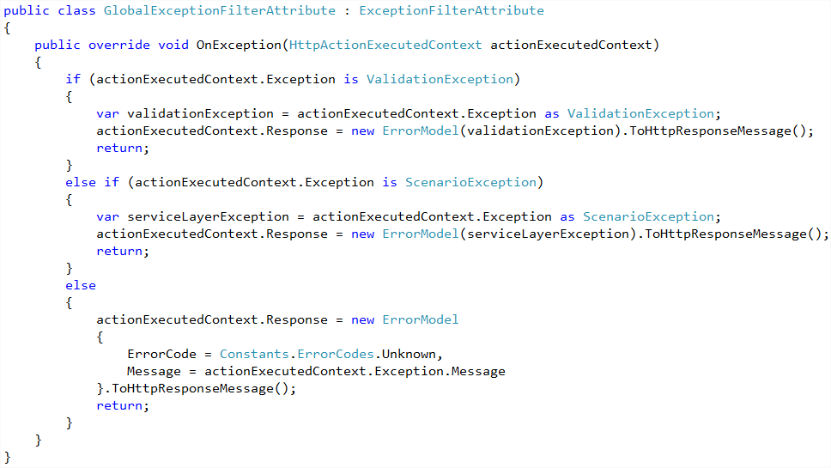
Throwing & Catching : Exception Filter Attribute
cf ErrorModel class

Slide 38
Throwing & Catching : Action Validation Filter
Validation Exception

Slide 39
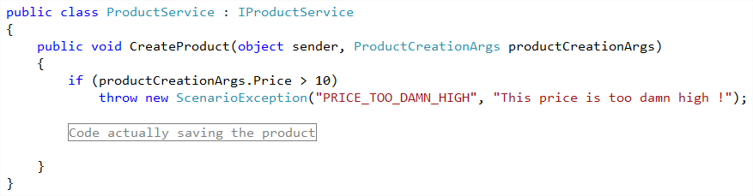
Throwing & Catching : scenario exceptions
Scenario Exception

Slide 40
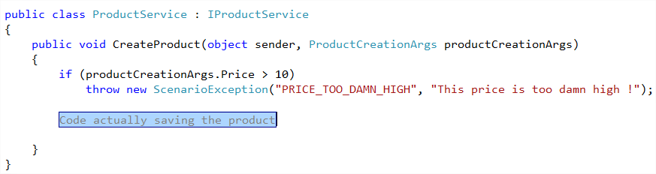
Throwing & Catching : system exceptions
System Exception

Slide 41
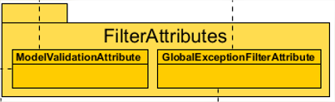
Throwing & Catching
3 Exceptions categories get handled
by one single class
Scenario Exception
Validation Exception
System Exception

Slide 42
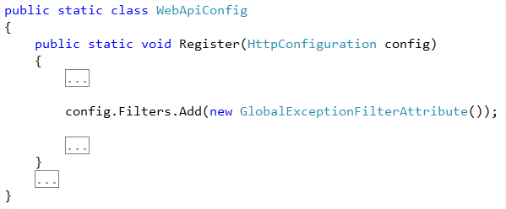
Throwing & Catching : making the filter global
The Exception Filter Attribute is applied to the entire API,
Not only for POST or PUT

Slide 43
Class Diagram : Exceptions
legend

Slide 44
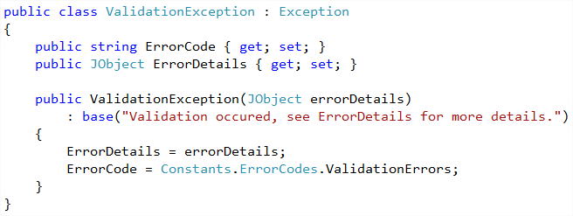
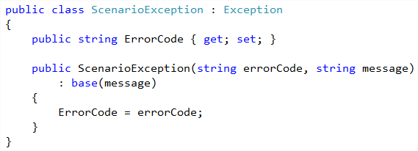
Throwing & Catching: Exceptions

Slide 45
Class Diagram : Error Model
legend

Slide 46
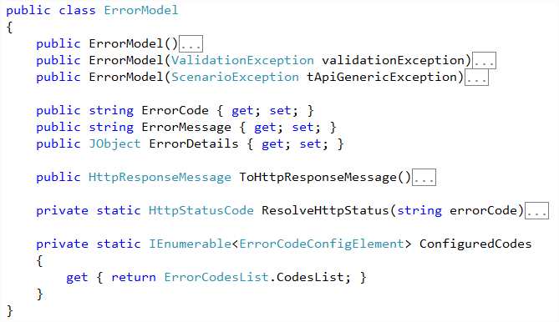
Class Diagram : Error Model

Slide 47
Some Sequence Diagrams

Slide 48
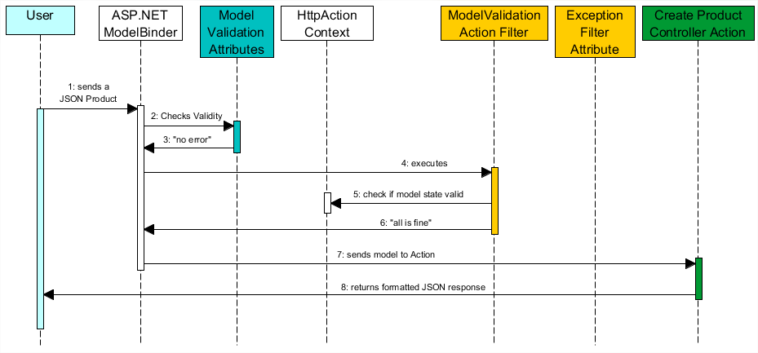
Nominal scenario

Slide 49
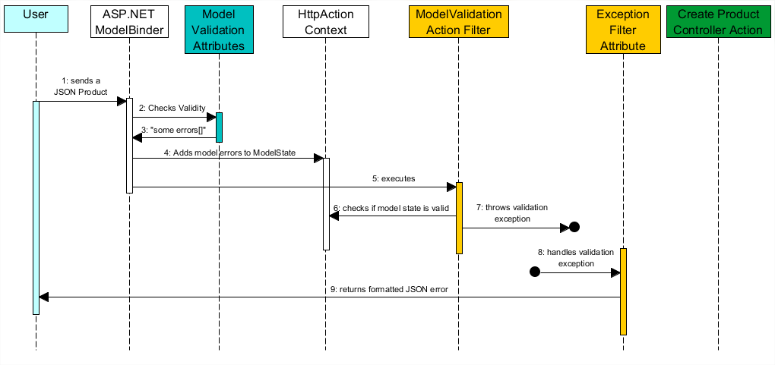
Validation errors

Slide 50
Helpers & Converters

Slide 51
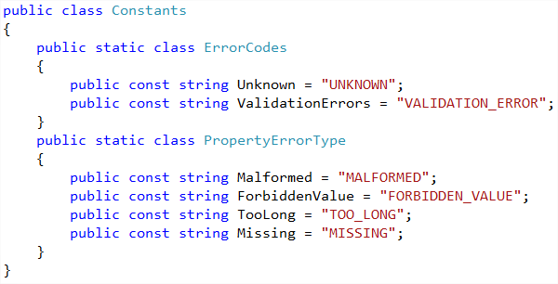
Helpers & Converters : constants

Slide 52
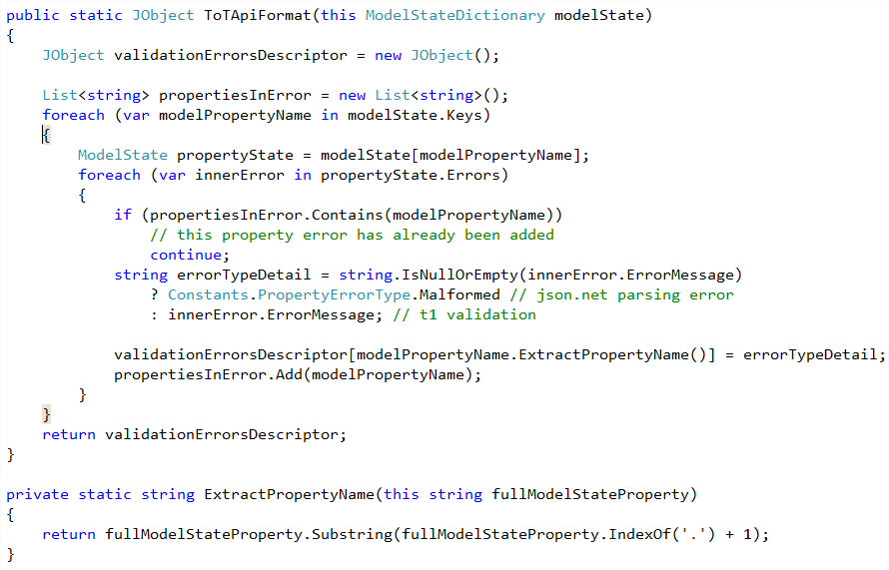
Helpers & converters : model errors extraction

Slide 53
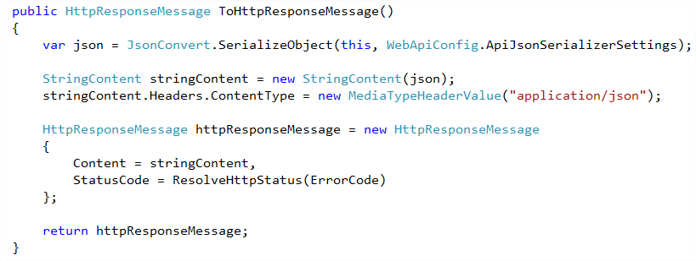
Helpers & Converters : ErrorModel’s HttpResponse Message conversion

Slide 54
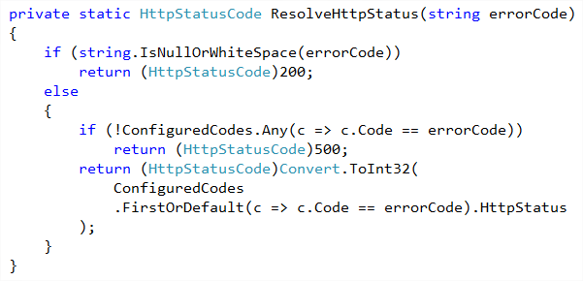
Helpers & Converters : HttpResponse Message conversion

Slide 55
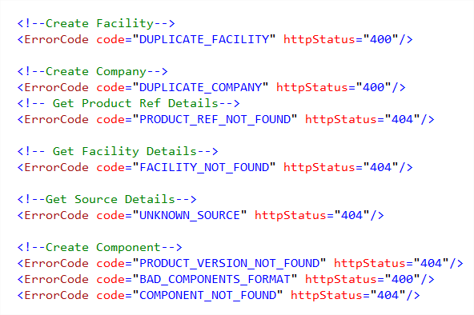
Helpers & Converters : Custom Error Config Section

Slide 56
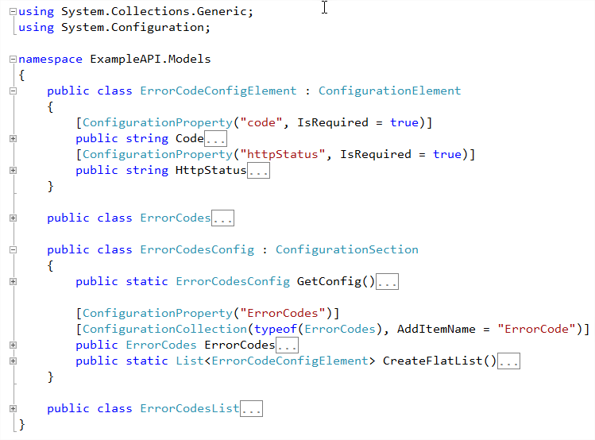
Helpers & Converters : custom error config section

Slide 57
Areas for improvement
JSON input validation : JSON Schema ?
Using Dictionary to retrieve client error messages
Business and Validation errors unification

Slide 58
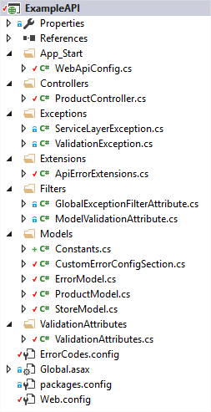
Example Solution
I created an example solution using this Error Handling System
T-API is also following this model

Slide 59
Do you have questions ?

